Slide 1
A Reflection on my E-Portfolio Assessment
By Dianne Ooi 2014

Slide 2
What were your initial thoughts of the assessment?

Slide 3
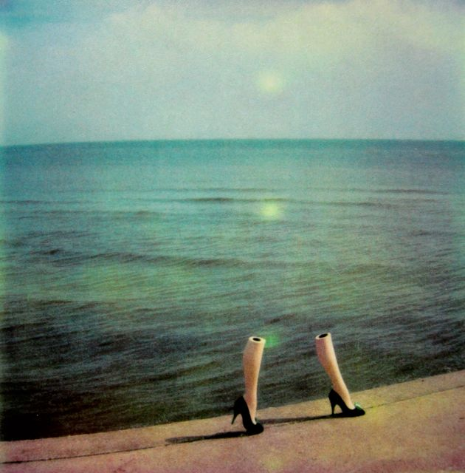
My initial thoughts were…
this is a creative way to formally document work that I am proud of and to express myself
Great way to reflect upon my university experiences
This could be something that I may potentially show to future employers
This assessment offers lots of creative freedom

Slide 4
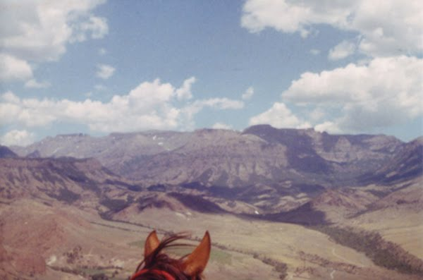
What value did I find in undertaking the assessment?

Slide 5
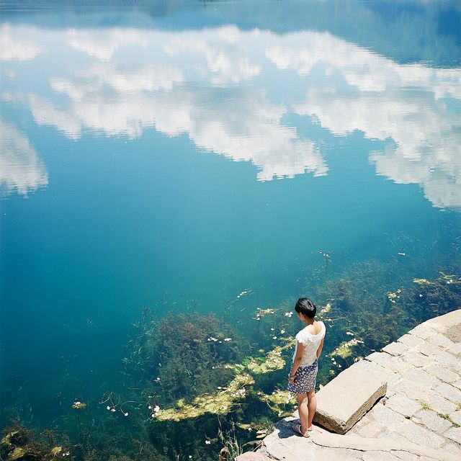
My thoughts…
The main thing I have gained from completing my e-portfolio is a sense of satisfaction knowing that I have completed a solid body of work and gained great experiences from my time at Deakin.
I’ve realised that now is the time to get involved, try new things and make connections whilst you are at university
I also gained the opportunity to express myself creatively- I was able to use different online platforms and digital mediums to document my work in which ever way I pleased. There was a lot of creative freedom which I really enjoyed!

Slide 6
What was the easiest/most challenging element?

Slide 7
My thoughts…
The easiest: Figuring out what to include as examples of my work. These jumped out relatively clearly to me. For example, the Teamwork Course Learning Outcome- I immediately could think of lots of times where I worked with others.
The hardest: Trying to figure out how to format Blogspot. Although I’ve used this platform before, there were a few little technical things that I had to look up, such as backdating posts and creating a home page. It took some time for me to learn how to properly set up a blog and navigate around it efficiently.
The other thing was probably reflecting upon my works and expressing what I had learnt from each Course Learning Outcome. Some questions that helped me along the way were: what skills did I improve on? What part of the assessment did I enjoy/didn’t enjoy? Has the work/experience opened new doors?

Slide 8
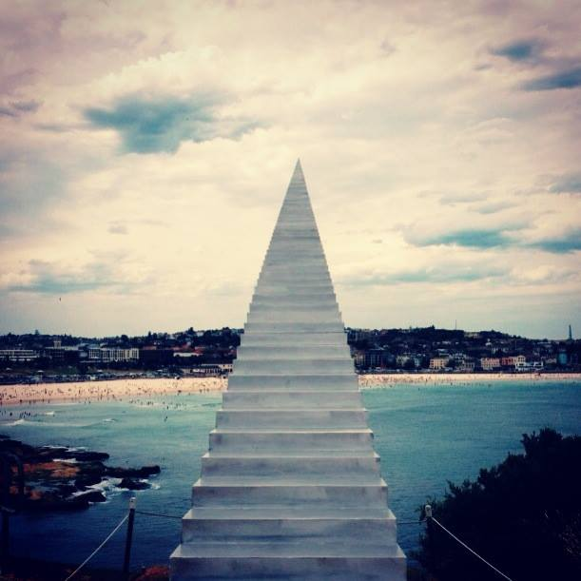
If I had to give another student one piece of advice it would be.....

Slide 9
…Get involved!
In terms of your overall university experience, tertiary education and career the best thing to do is to throw yourself out there. It may sound scary at first, but the more you get involved in your university life, the more you can develop and build upon your experiences.
Whether its joining a sport team, a language class, a exchange/study abroad program or a volunteer project, getting yourself out there and participating in different activities will allow you to meet new people and discover or feed your interests.
Now is the time to try everything. Jump online and comb through all the different activities and opportunities Deakin has to offer!

Slide 10
…look forward (and then backtrack)
The other thing I think is a good idea is to think about where you want to go in terms of your career.
Look at your dream job- that job waaay beyond your dreams.
Then back track and look at the skills you need to get to that dream job.
From there, think about the experiences and activities in which you can participate that will enable you to gain those skills.
Then from there, get involved and jump straight into the deep end!
Start NOW

Slide 11
And one other thing…
Grades count!!!
During your graduate year, your future employers will DEFINITELY ask for a copy of your academic transcript.
So keep this in mind : )

